Slide 1
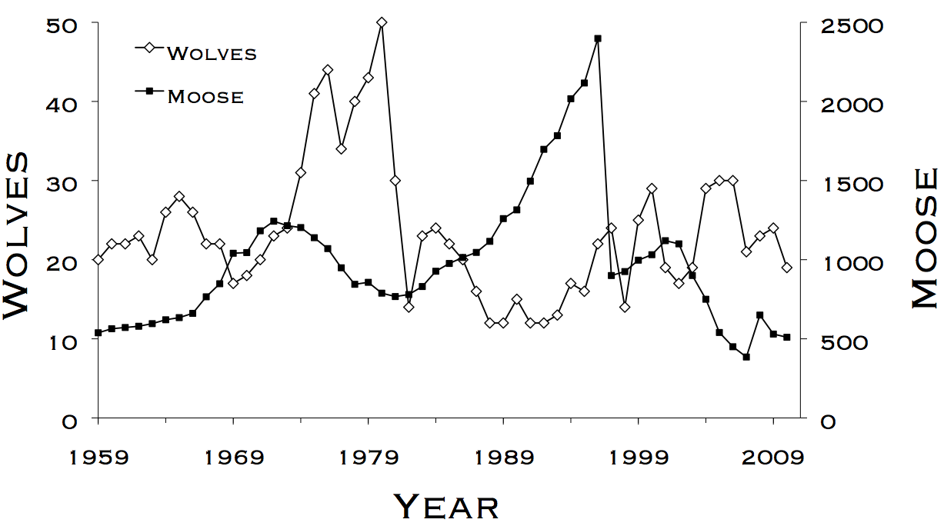
Lab 9 – Distance Sampling for the Zombie Apocalypse
WLE 411, Week 15

Slide 2

Why zombies?
Notes:
Historically taught at Halloween, now become a tradition

Slide 3
What is distance sampling?
A method for measuring density of unmarked individuals measured from point or line transects
Assumptions:
Detectability decreases with distance from transect
Density is uniform in respect to distance from transect

Slide 4
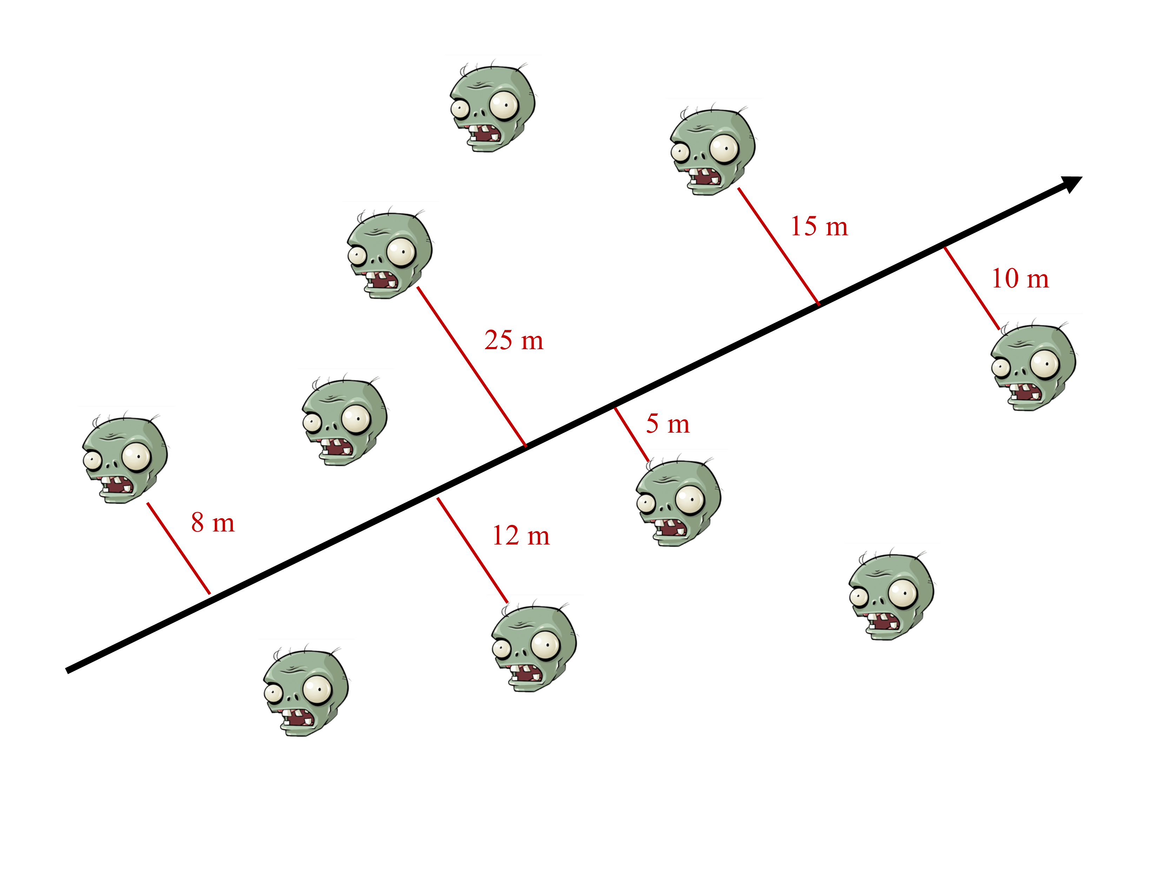
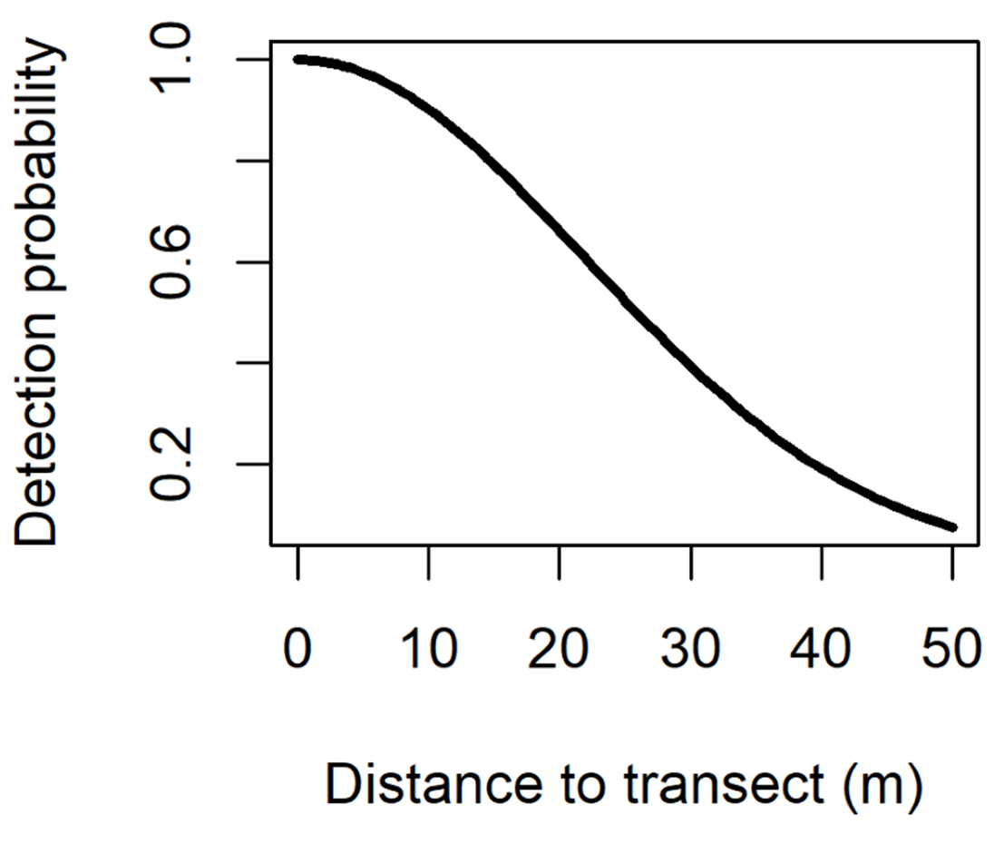

Slide 5
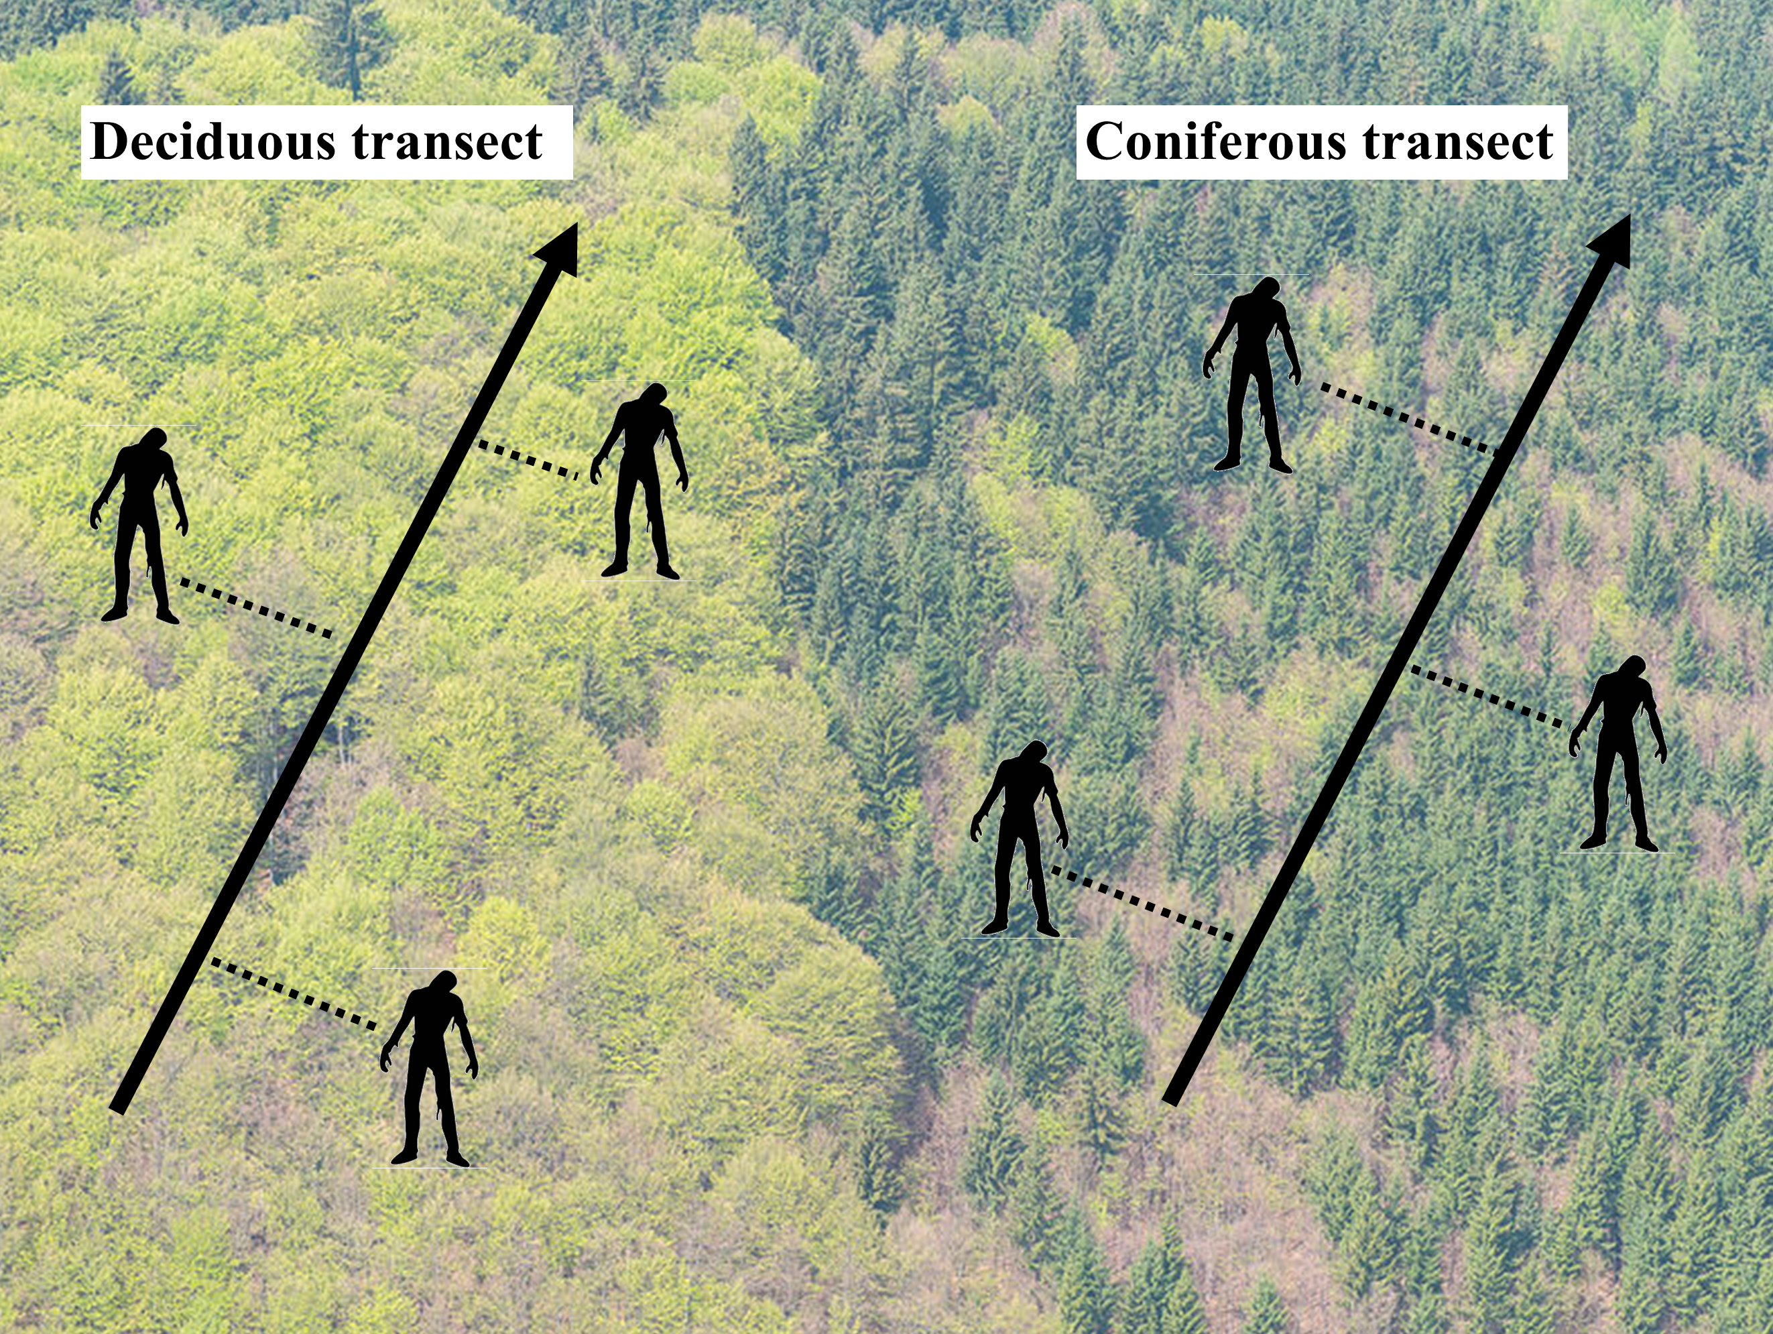

Slide 6
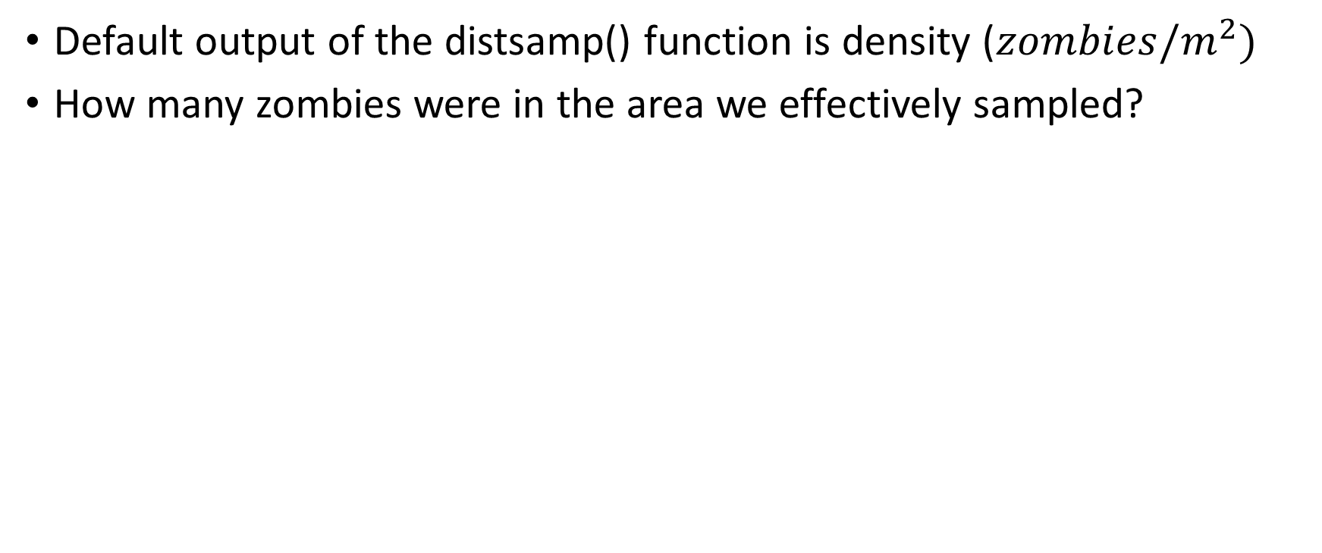
Calculating zombie densities
Default output of the distsamp() function is density (${zombies/m}^{2})$
How many zombies were in the area we effectively sampled?

Slide 7






Calculating zombie densities
Nominal sampling distance: 50 m
Effective sampling distance: 16 m
$$Zombies in sampled area=Density ∗ Transect length ∗Effective sampling distance$$

Slide 8
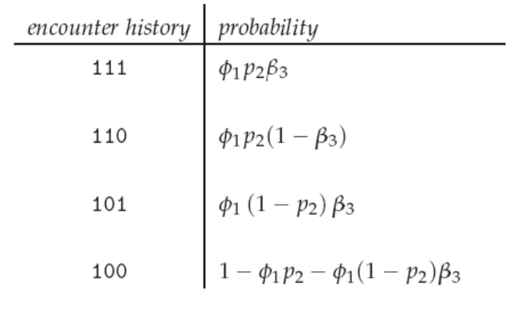
Themes of WLE 411
Animals can be counted using both marked and unmarked techniques
Cormack-Jolly-Seber
Distance Sampling
Notes:
CJS vs. distance sampling

Slide 9
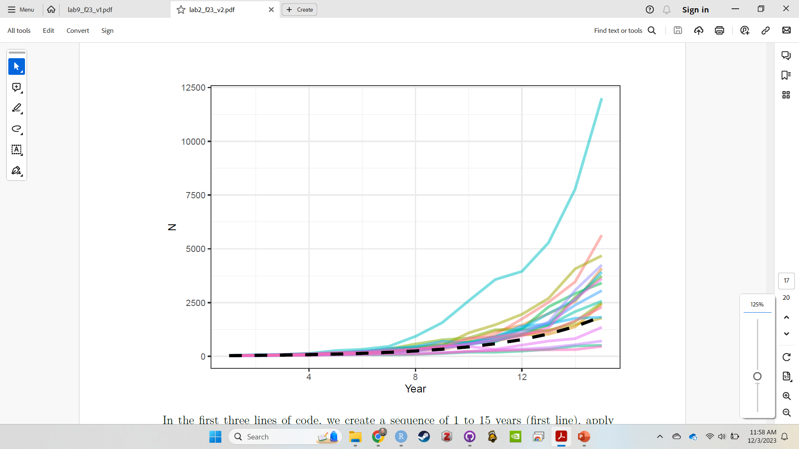
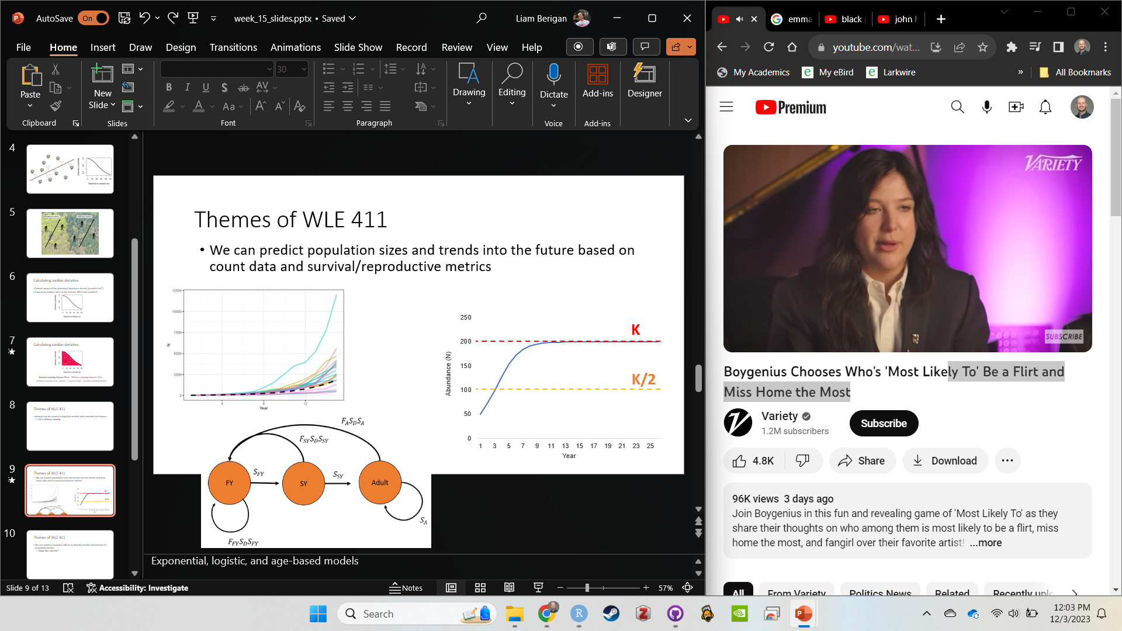
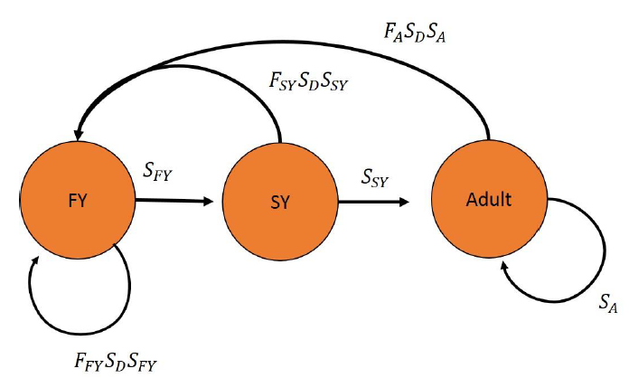
Themes of WLE 411
We can predict population sizes and trends into the future based on count data and survival/reproductive metrics
Exponential
Logistic
Age-based
Notes:
Exponential, logistic, and age-based models

Slide 10
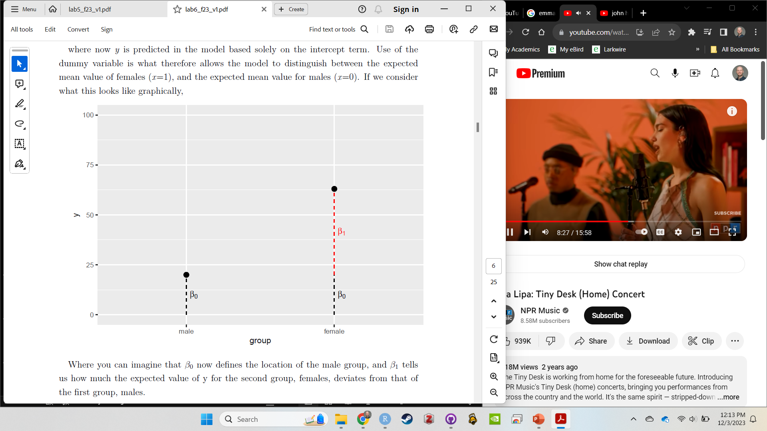
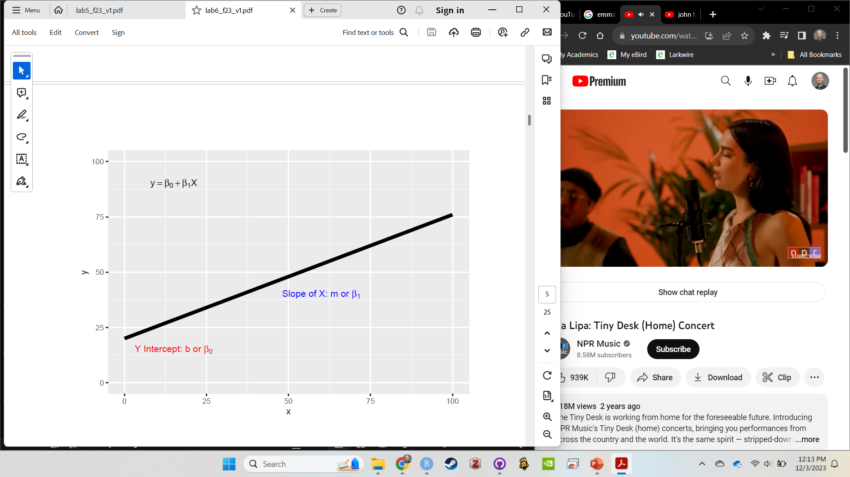
Themes of WLE 411
We can examine covariates effects to identify possible mechanisms of population decline
Categorical
Continuous
Notes:
Known fate: Labs 6 & 7

Slide 11
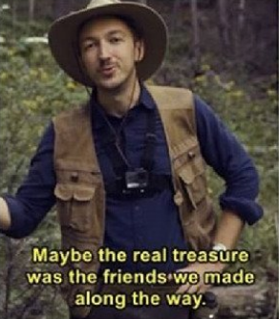
General familiarity with quantitative techniques
Learning to use Excel and R
Interpreting results and statistics
Turning data into management recommendations

Slide 12
Last course reminders
This lab is due in one week
Lab 7 revisions are due on the same day
Final grades are due to the university on Dec. 23rd
If you have any questions/concerns, let me know ASAP

Slide 13
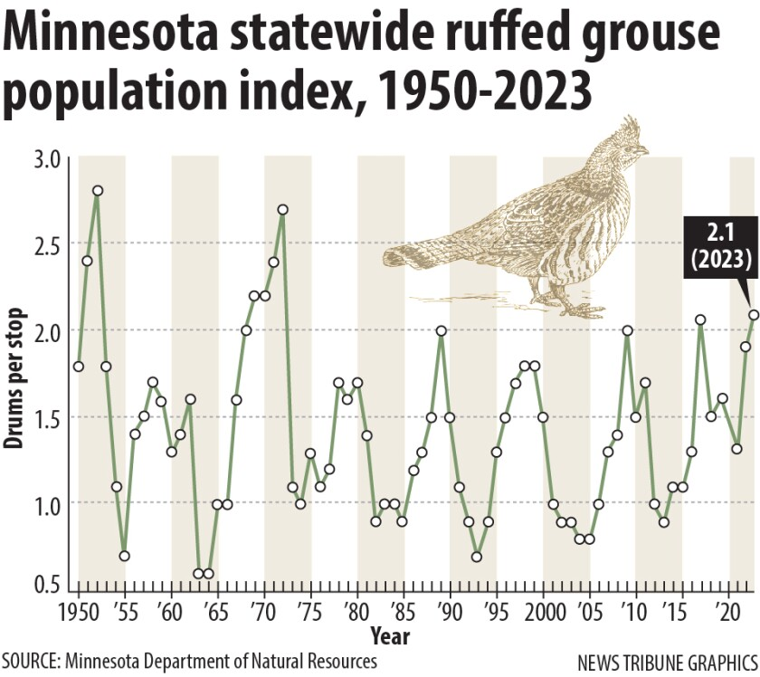
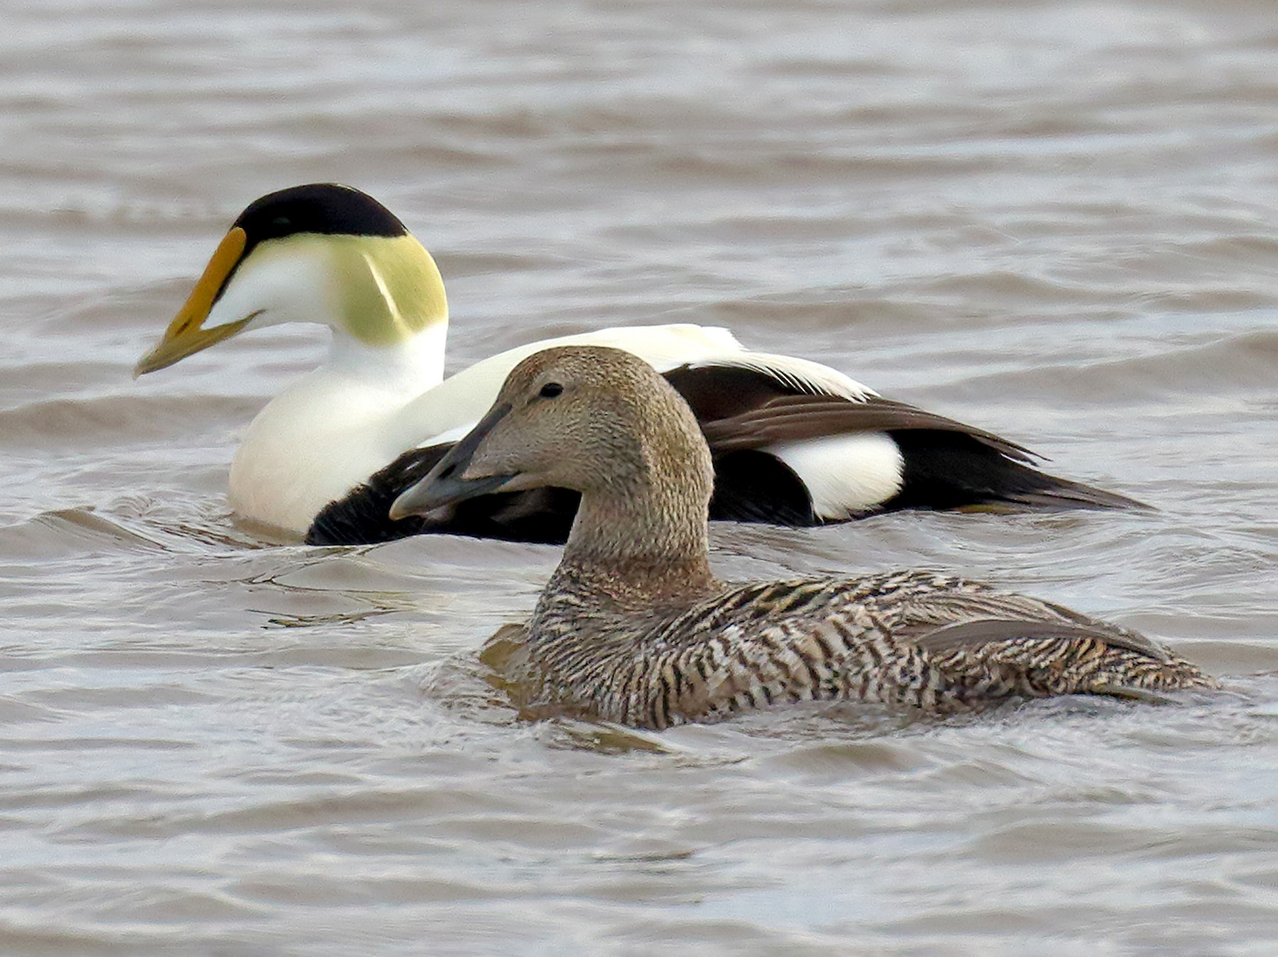
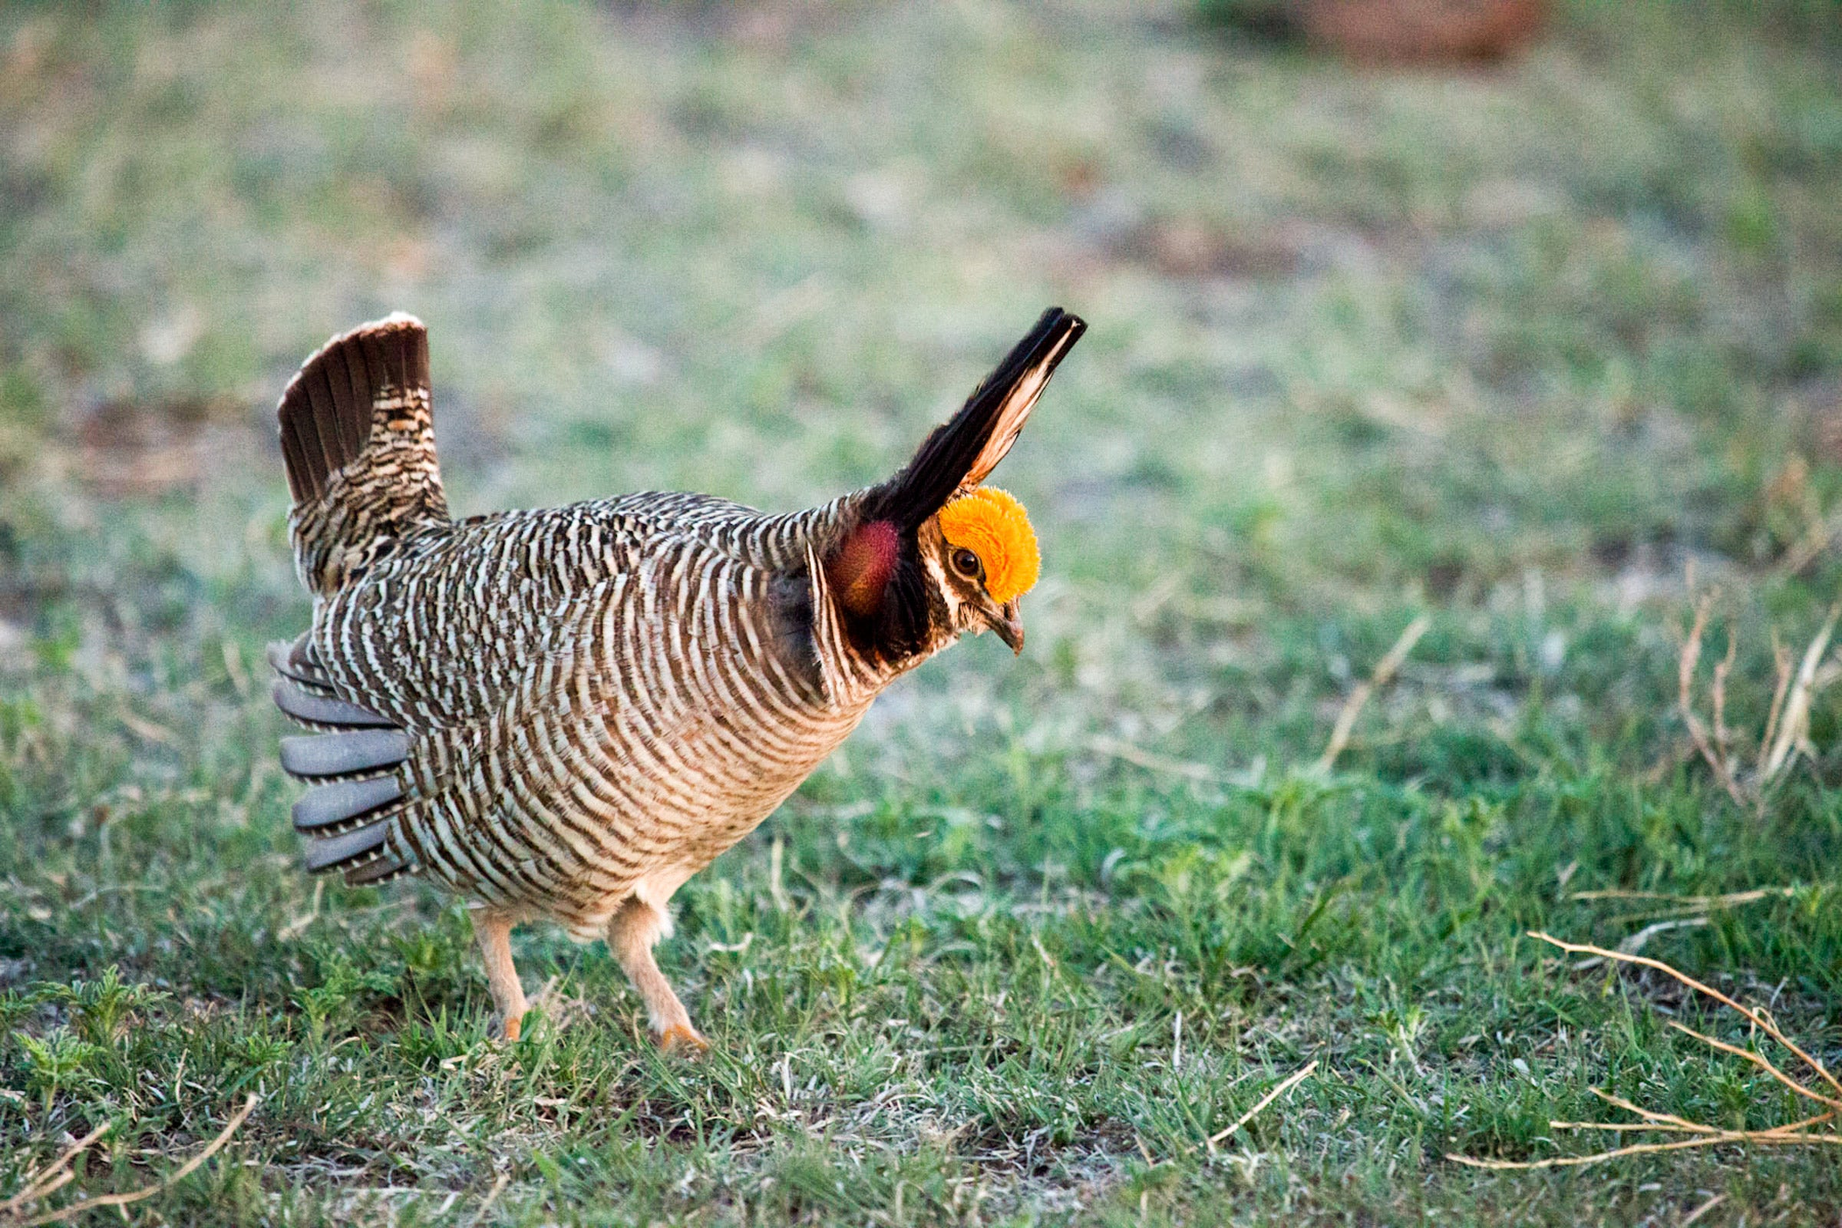
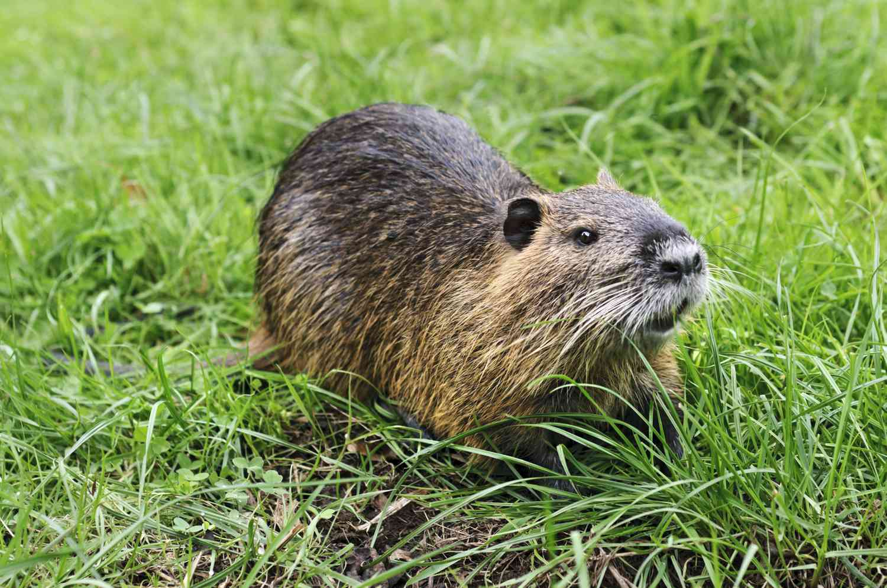
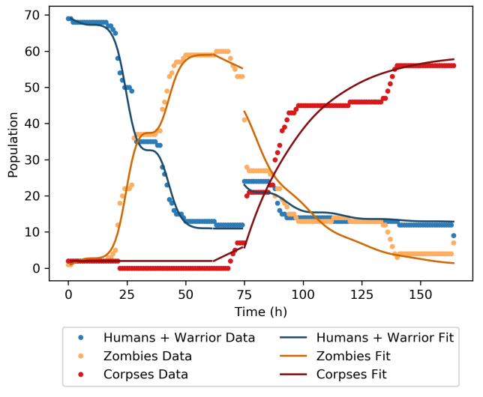
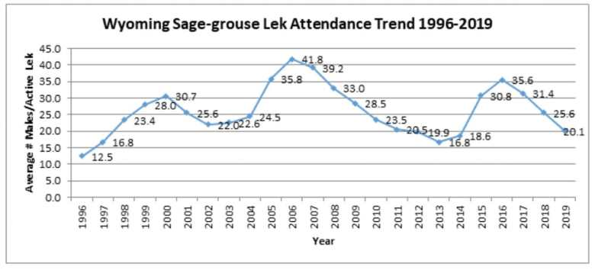

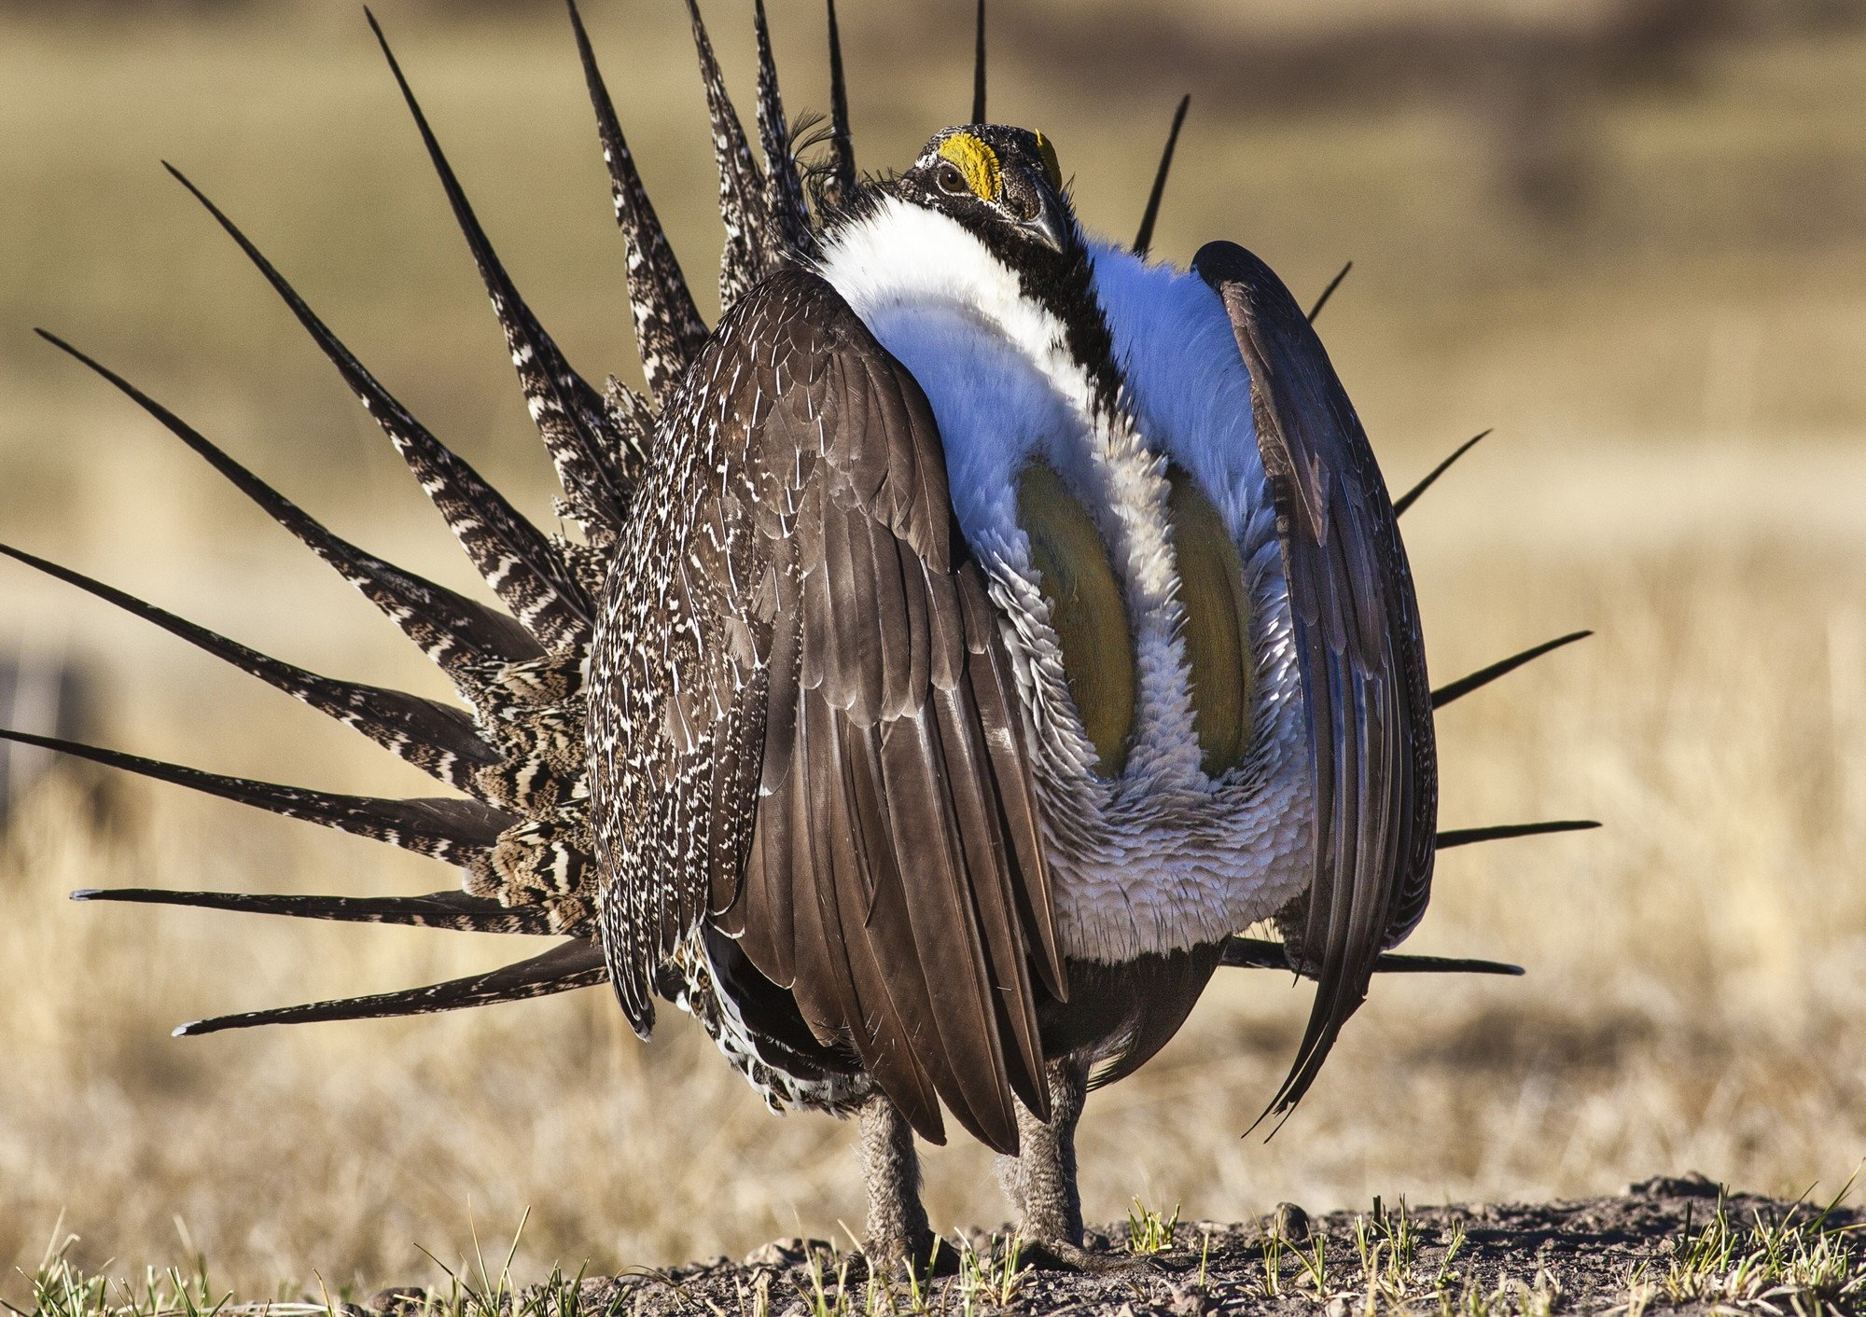
Thanks for a great semester!

